Slide 1
Parking Reservation System
Advaith Kamath
Manan Dedhia

Slide 2
Background
Parking has always been an issue for Syracuse University food services
Parking Lot is used by Customers to book parking spot
Parking slot can be selected by the customer based on his convenience
Admin can add parking spots to new location based on trigger

Slide 3
Business Rules
Parking cost for 10$ per hour
Customer can select parking slot of his choice
Customer must enter Entry time and Exit time in advance while reserving parking spots
We do not handle payments
Payments are handled by the Admin of the system who is present at all times
Based on overtime , overtime amount is calculated by the admin
Initially, when a new location is added only 25 new spots are added by a trigger
Admin notes exit time and notes whether there was an overtime or not

Slide 4
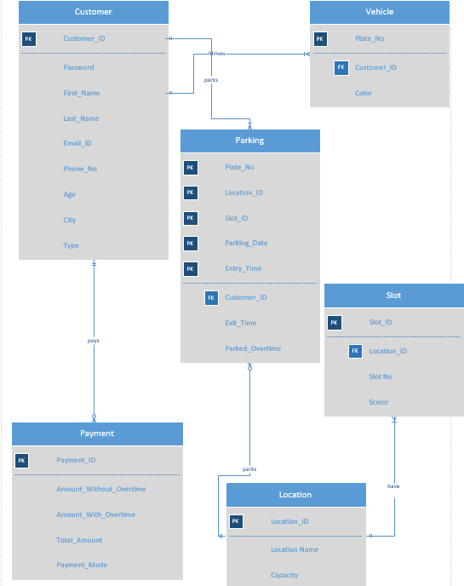
Entity Relational Diagram

Slide 5
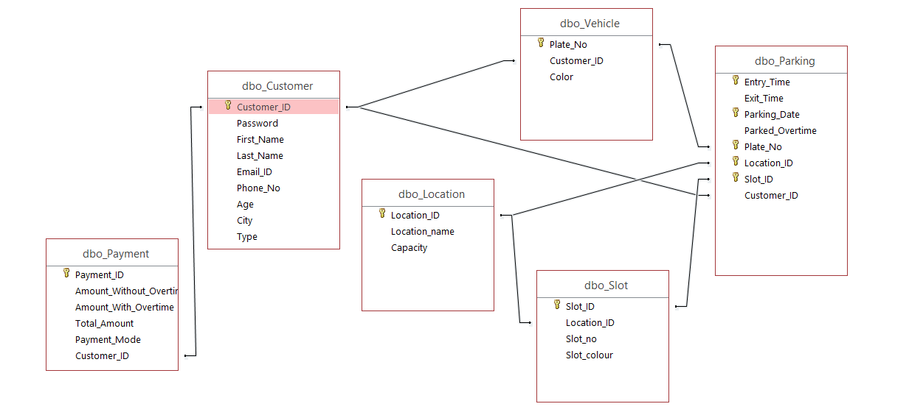
Relationship in Access

Slide 6
Trigger
DROP TRIGGER Enter_Slot
CREATE TRIGGER Enter_Slot ON Location
AFTER INSERT AS
IF @@ROWCOUNT=1
BEGIN
DECLARE @Loc_ID VARCHAR(10)
DECLARE @Slot_ID VARCHAR(10)
DECLARE @COUNT INT
SET @COUNT=1;
SELECT @Loc_ID=L.Location_ID
FROM Location L LEFT OUTER JOIN Slot S
on L.Location_ID= S.Location_ID
WHERE S.Location_ID is null
WHILE @COUNT<6
BEGIN
INSERT INTO Slot(Location_ID,Slot_ID,Slot_colour,Slot_no)
VALUES(@Loc_ID,CONCAT(@Loc_ID,@COUNT,'G'),'Green',@COUNT)
INSERT INTO Slot(Location_ID,Slot_ID,Slot_colour,Slot_no)
VALUES(@Loc_ID,CONCAT(@Loc_ID,@COUNT,'B'),'Blue',@COUNT)
INSERT INTO Slot(Location_ID,Slot_ID,Slot_colour,Slot_no)
VALUES(@Loc_ID,CONCAT(@Loc_ID,@COUNT,'R'),'Red',@COUNT)
INSERT INTO Slot(Location_ID,Slot_ID,Slot_colour,Slot_no)
VALUES(@Loc_ID,CONCAT(@Loc_ID,@COUNT,'Y'),'Yellow',@COUNT)
INSERT INTO Slot(Location_ID,Slot_ID,Slot_colour,Slot_no)
VALUES(@Loc_ID,CONCAT(@Loc_ID,@COUNT,'O'),'Orange',@COUNT)
SET @COUNT=@COUNT+1
END
END

Slide 7
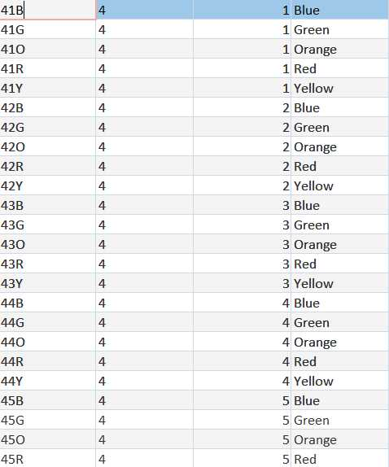
Database after trigger Implementation

Slide 8
DEMO

Slide 9
Data Questions
What is total amount of money generated ?
How many Customers registers to get parking slot?
Which location has more number of parking ?

Slide 10
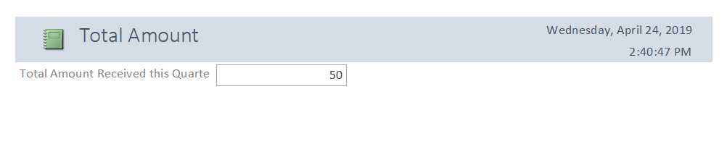
What is total amount of money generated ?

Slide 11
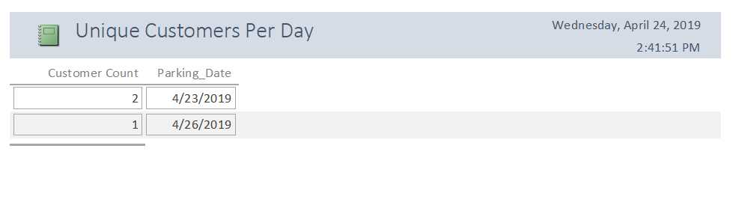
How many Customers registers to get parking slot?

Slide 12
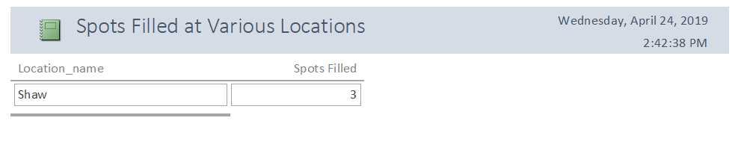
Which location has more number of parking ?

Slide 13
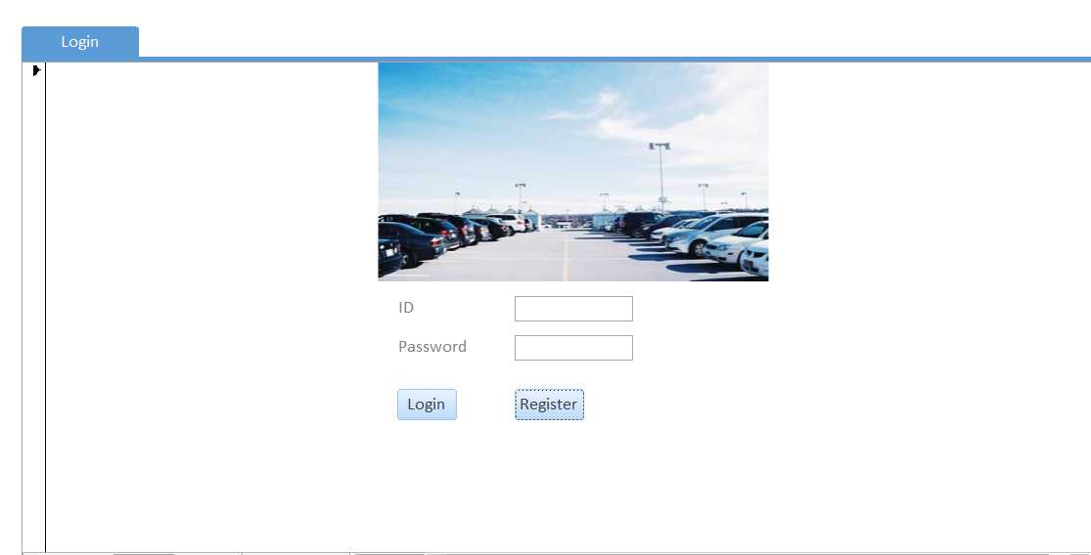
Login Form

Slide 14
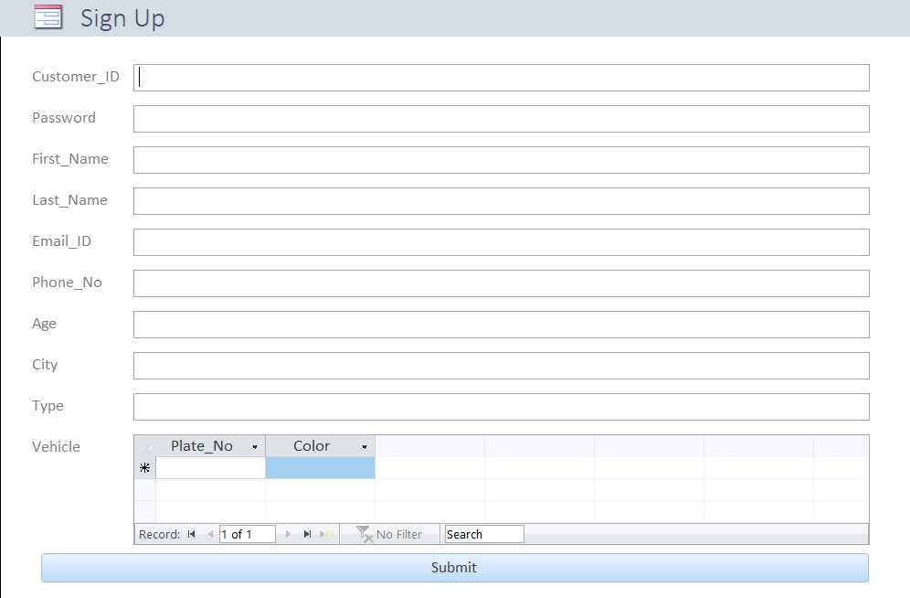
Sign up form

Slide 15
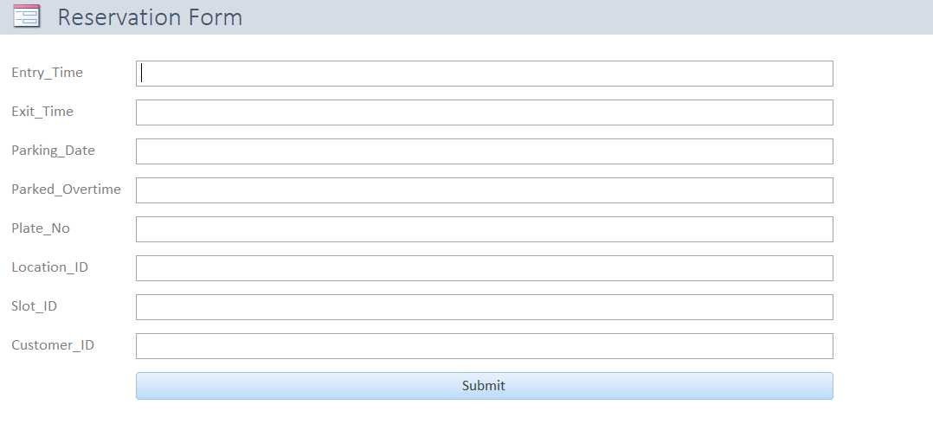
Reservation form

Slide 16
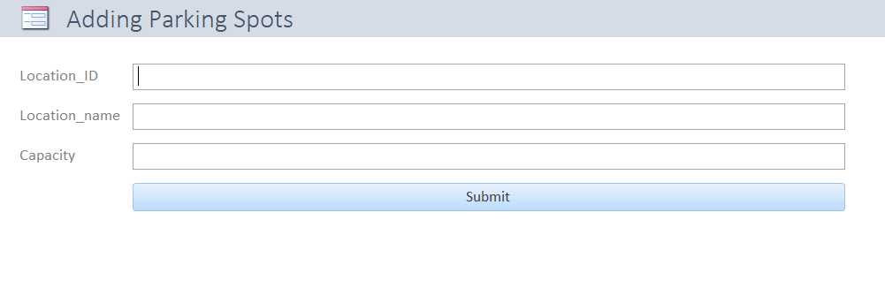
Adding parking spots

Slide 17
Thank you

